Slide 1
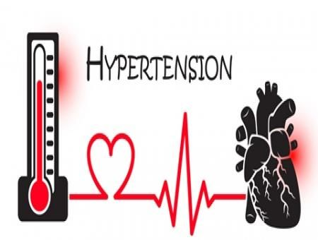


Sarah Taaghi MD
Cardiovascular specialist
Assistant professor of Cardiology
IUMS – Rasoul Akram Hospital

Slide 2
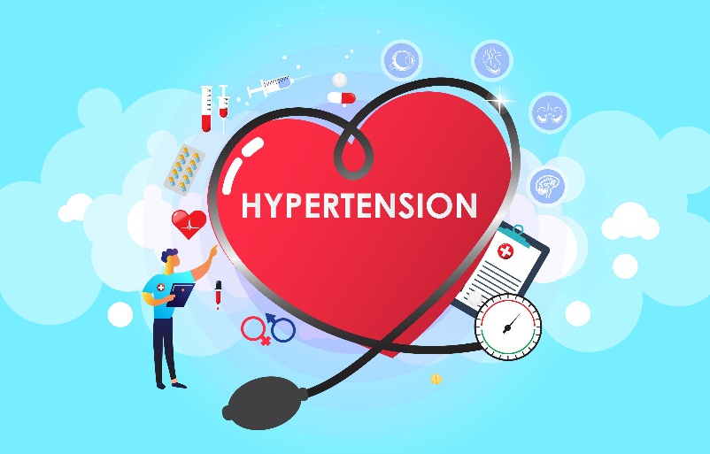

key contributor to premature morbidity and mortality:
Ischemic heart disease , MI
Stroke , ICH (the most important modifiable risk factor for stroke)
Heart failure
Atrial fibrillation
CKD (the second most common cause of end-stage kidney disease)
Peripheral vascular disease (PAD)
Aortic dissection
Memory loss (cognitive impairment)

Slide 3
Definition
Isolated Systolic HTN → SBP => 130 mmHg , DBP< 80
Isolated Diastolic HTN → SBP <130 mmHg , DBP> = 80
Mixed → → SBP => 130 mmHg , DBP> = 80

Slide 4
Definition (ACC/AHA 2017)
Normal blood pressure :
Systolic <120 mmHg and diastolic <80 mmHg
Elevated blood pressure :
Systolic 120 to 129 mmHg and diastolic <80 mmHg
Hypertension:
Stage 1 – Systolic 130 to 139 mmHg or diastolic 80 to 89 mmHg
Stage 2 – Systolic at least 140 mmHg or diastolic at least 90 mmHg

Slide 5
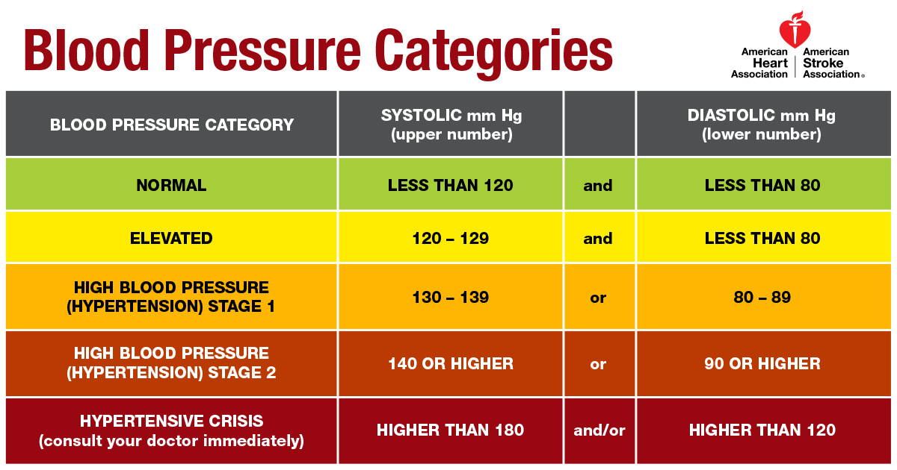

Slide 6
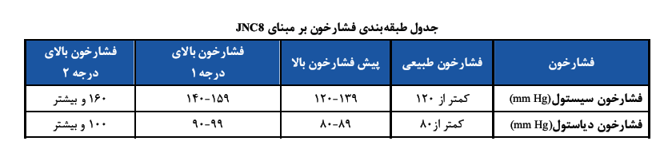

Slide 7




Sedentary life style
Obesity , overweight
Alcohol
Caffeine
Smoking

Slide 8


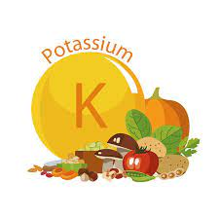
6. Emotional stress
7. Salt
8. low K

Slide 9
Environmental effect on HTN
Sedentary life style
Emotional stress
Smoking
Alcohol usage
Caffeine
Obesity
More Sodium intake
Less potassium and calcium intake
Urinary Na / K

Slide 10

HTN & genetics
30%
Multiple
If one parent has HTN →
the risk is double for children

Slide 11
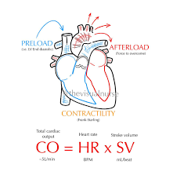
Regulation of blood pressure
Heart → cardiac output ( CO )
Vessels → peripheral resistance
Kidneys
CO : Stroke Volume x HR
SV: contractility , venous return (preload ), afterload
Preload : vascular tone , volume

Slide 12
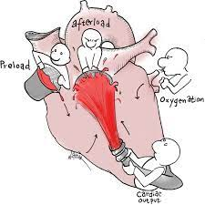

Slide 13
HTN Mechanism
Intravascular volume
Autonomic nervous system
Renin – Angiotensin - Aldosterone system (RAAS)
Vascular resistance
Renal artery stenosis
Endocrinal disease

Slide 14
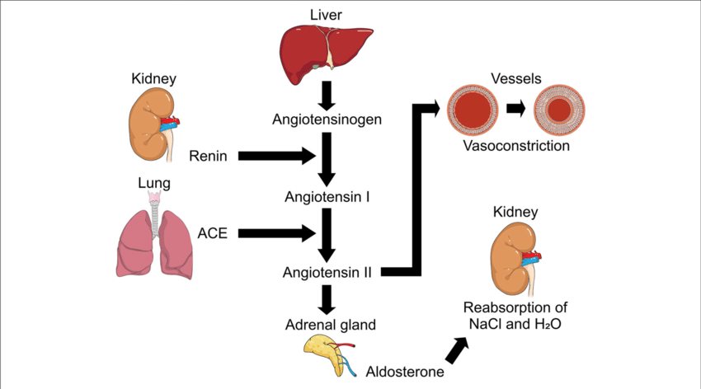

Slide 15


Slide 16
HTN complications
Heart
One of main risk factors for CAD
Main etiology of mortality in hypertensive patients : cardiac disease
Cause :
Left ventricular hypertrophy
Atrial fibrillation
Herat failure (HFpEF/ HEFrEF)

Slide 17
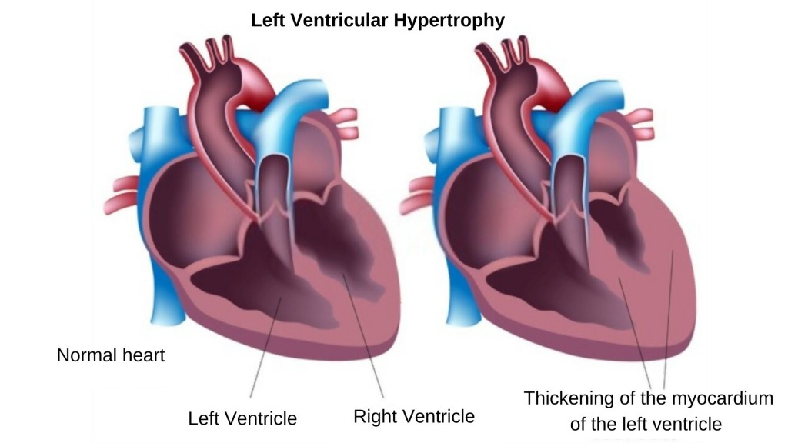
HTN complications
Heart
Cause :
Left ventricular hypertrophy

Slide 18
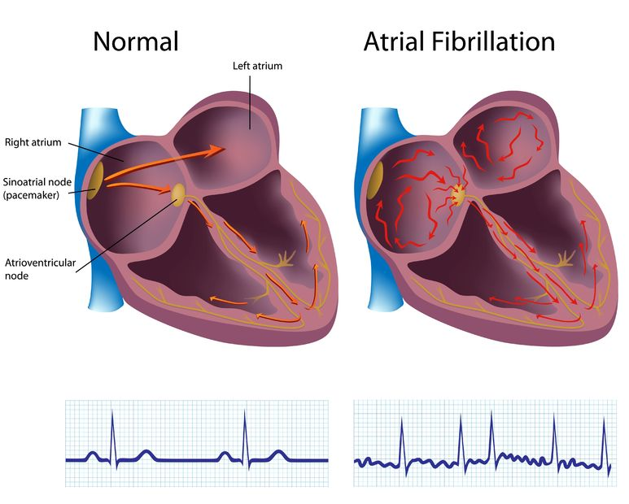
HTN complications
Heart
Cause :
Atrial fibrillation

Slide 19
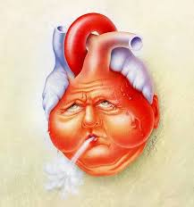
HTN complications
Heart
Cause :
Herat failure (HFpEF/ HFrEF)

Slide 20
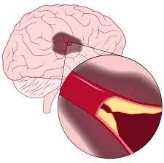
HTN complications
Brain
Ischemic stroke

Slide 21
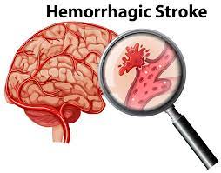
HTN complications
Brain
2. ICH , SAH

Slide 22

HTN complications
Brain
3.Cognitive impairment
4.Hypertensive encephalopathy

Slide 23
HTN complications kidneys
After diabetic nephropathy , main cause of ESRD
Mainly cause : benign nephrosclerosis
SBP > DBP
Black race
Microalbuminuria

Slide 24
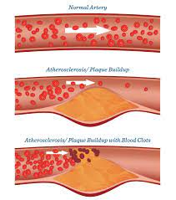
HTN complications
Arterial
Rapid atherosclerosis

Slide 25
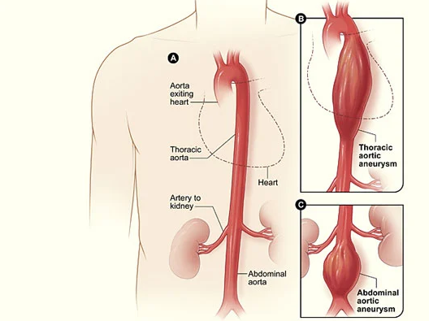
HTN complications
Arterial
2. Dilatation and aneurysm formation due to mechanical stress

Slide 26
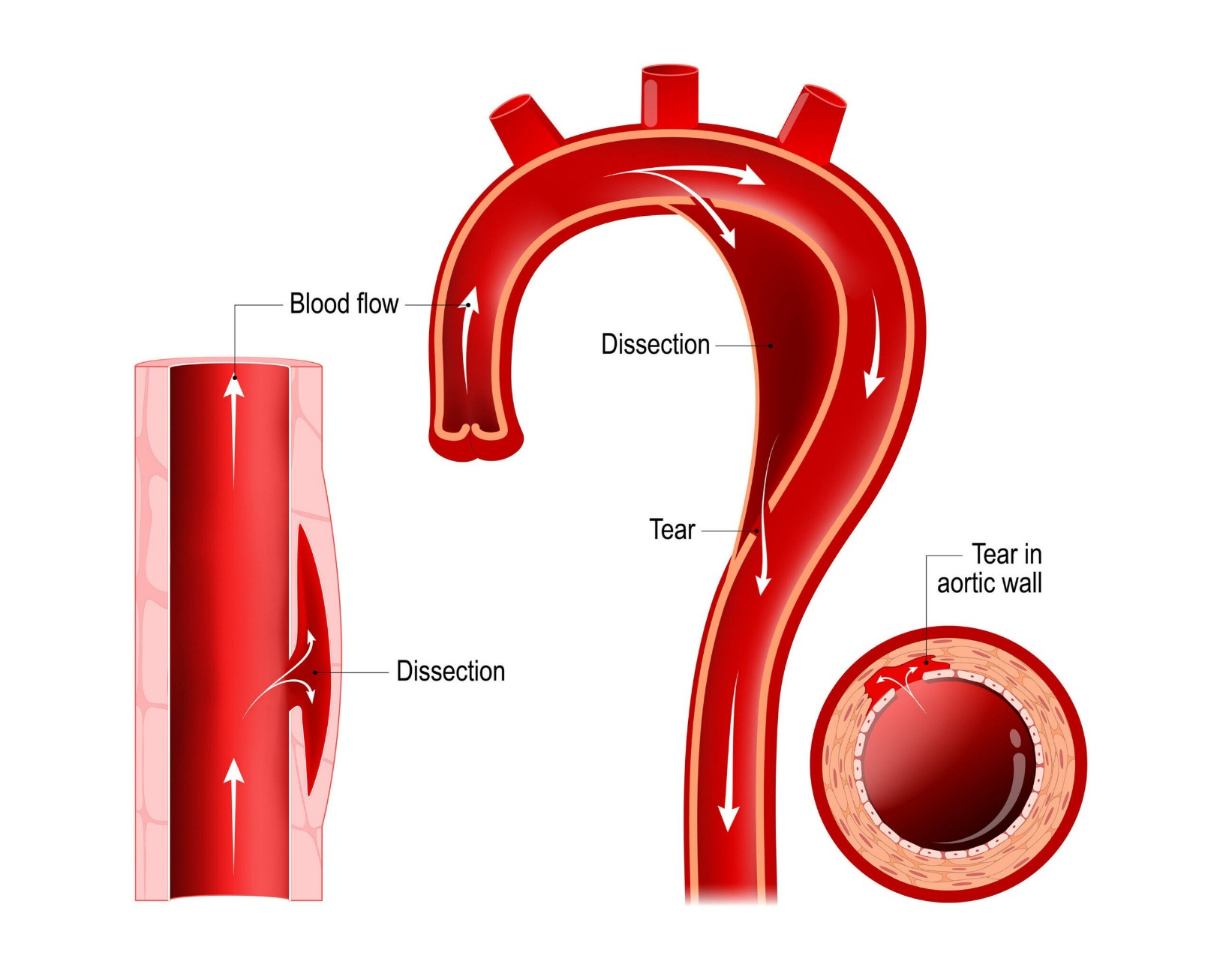
HTN complications
Arterial
3. Dissection ( media degeneration and intimal tearing)

Slide 27
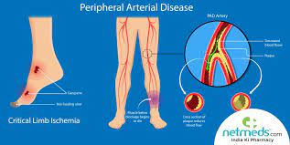
HTN complications
Arterial
4. PAD → claudication , ischemic wound , amputation

Slide 28
HTN type
Primary (essential) HTN
Secondary HTN

Slide 29
HTN type
Primary (essential) HTN
80 -90 %
No detectable cause
Systolic HTN in adolescent and young adults
Diastolic HTN in adults
Isolated Systolic HTN in elderly

Slide 30
HTN type
Primary (essential) HTN
Systolic HTN in adolescent and young adults :
17-25 y
Aortic stiffness and high CO → increase sympathetic nervous system
More in male
Tend to diastolic HTN in adulthood

Slide 31
HTN type
Primary (essential) HTN
Diastolic HTN in adults :
30-50 y
If untreated can be Mixed
Isolated diastolic : more in male
Overweight
Increase in systemic resistance and CO

Slide 32
HTN type
Primary (essential) HTN
Isolated Systolic HTN in elderly :
> 55y
SBP > 140 and DBP< 90
Aortic stiffness due to ageing
More in female

Slide 33
HTN type
Secondary HTN
Renal disease
Renal arterial stenosis
Aortic coarctation
Endocrine : acromegaly , thyroid , hypercalcemia
Adrenal : primary hyperaldosteronism
Cushing syndrome
Obstructive sleep apnea (OSA)
Drug

Slide 34
HTN type
Secondary HTN – Renal disease
Max cause of secondary : parenchymal disease of kidneys
The Sick loop!!
Early detection : by micro albuminuria , sole cr is not enough
Proteinuria > 1000mg with active urinary sediments are in favor of primary renal disease

Slide 35
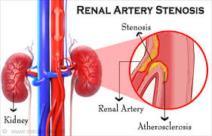
HTN type
Secondary HTN – Renal artery stenosis
85% due to atherosclerosis :
More in elderly and CAD
Ostial involvement

Slide 36
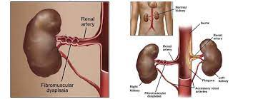
HTN type
Secondary HTN – Renal artery stenosis
Fibromuscular dysplasia (FMD):
More in female
2/3 distal involvement

Slide 37
HTN type
Secondary HTN – Renal artery stenosis
The main mechanism :
RAAS activation due to ischemia
In severe cases :
Ischemic nephropathy
Pulmonary edema

Slide 38
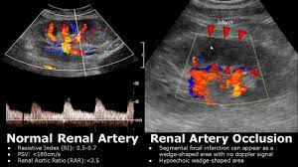
HTN type
Secondary HTN – renal artery stenosis
Screening :
Doppler US ( sen 75%)

Slide 39
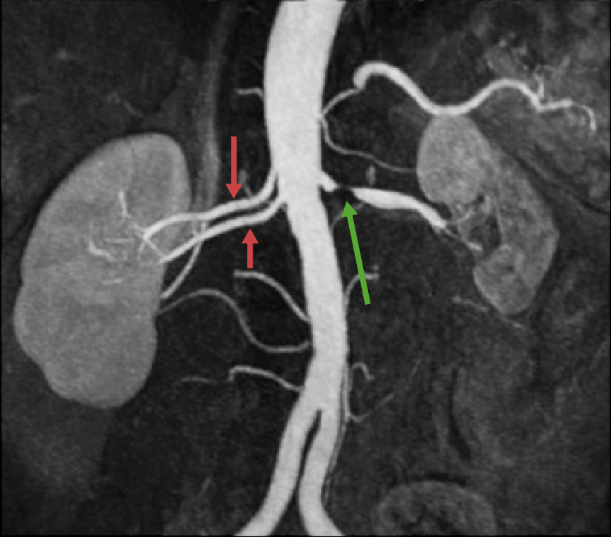
HTN type
Secondary HTN – renal artery stenosis
best non invasive test :
CT angiography

Slide 40
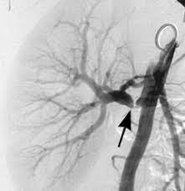
HTN type
Secondary HTN – renal artery stenosis
Gold standard :
DSA , digital subtraction angiography

Slide 41
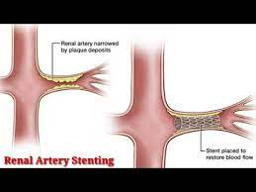
HTN type
Secondary HTN – renal artery stenosis
Treatment :
For FMD → balloon angioplasty without stenting
For atherosclerotic → smoking cessation , medical treatment , stenting for resistance HTN and recurrent pulmonary edema

Slide 42
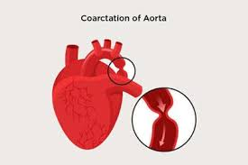
HTN type
Secondary HTN – Aortic coarctation
Main cause of HTN in children
Mainly sporadic
In 10 % of turner syndrome

Slide 43
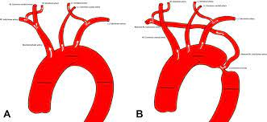
HTN type
Secondary HTN – Aortic coarctation
** aorta stenosis just distal to origin of left SCA →
high BP in root , upper limb and head
Lower BP in descending aorta , lower limb

Slide 44
HTN type
Secondary HTN – Aortic coarctation
Physical findings :
Upper BP > lower BP
Right arm BP > left
Systolic murmur in back , between scapula
Diminished femoral pulse

Slide 45
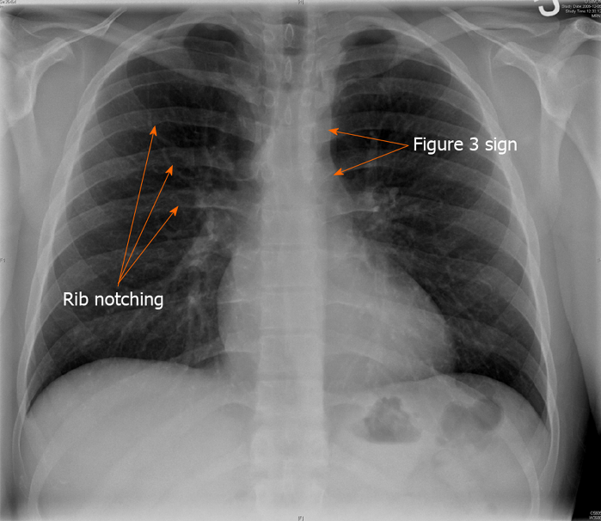
HTN type
Secondary HTN – Aortic coarctation
Chest X ray

Slide 46
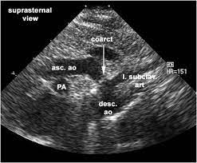
HTN type
Secondary HTN – Aortic coarctation
Echocardiography

Slide 47
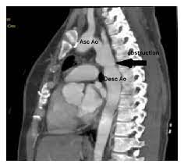
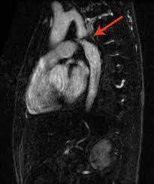
HTN type
Secondary HTN – Aortic coarctation
CT Angiography MR Angiography

Slide 48
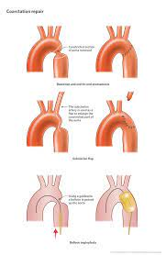
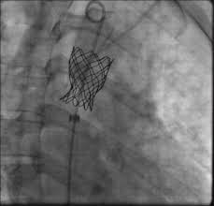
HTN type
Secondary HTN – Aortic coarctation
Surgical repair
Coarctoplasty
ACEI
After repair → 30 % HTN remain

Slide 49
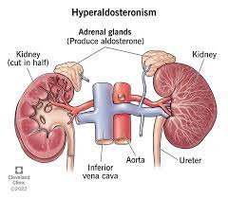
HTN type
Secondary HTN primary hyperaldosteronism
90 % due to unilateral adrenal adenoma or benign bilateral hyperplasia
Rare due to adrenal carcinoma (>2cm)
3-5 decade
5-10% of resistance HTN cases

Slide 50
HTN type
Secondary HTN primary hyperaldosteronism
High serum aldosterone → activation of distal tubule → retention of Na and water , excretion of K → Increase in volume
HTN
Hypokalemia → muscle weakness , paresthesia , polyuria , polydipsia
Metabolic alkalosis

Slide 51
HTN type
Secondary HTN primary hyperaldosteronism
K < 3.1 meq/lit with diurethic
CT for all suspisious cases
Aldosteron is not dependent to renin → increase in Aldosterone / renin→ screening test (> 15)
ACEI , ARB → incraese renin
Renal failure → increase aldosterone

Slide 52
HTN type
Secondary HTN primary hyperaldosteronism
If Ald/ renin is positive →3 days oral salt loading and the effect on 24 h urine aldosterone
IV normal saline suprresion test is not recommended

Slide 53
HTN type
Secondary HTN primary hyperaldosteronism
Surgical
Adrenal venous aldosterone → unilateral vs bilateral
Unilateral ( conn syndrome ) → laparoscopic adernectomy → HTN is cured in 30 -60 %
For transient hypoaldosteronism after surgery and hyperkalemia → diuretics , fludrocortisone

Slide 54
HTN type
Secondary HTN primary hyperaldosteronism
Bilateral → medical
Aldosterone antagonist , K sparing diuretics

Slide 55
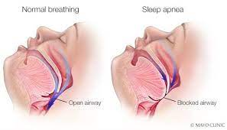
HTN type
Secondary HTN - OSA
Increase HTN severity
Obesity

Slide 56
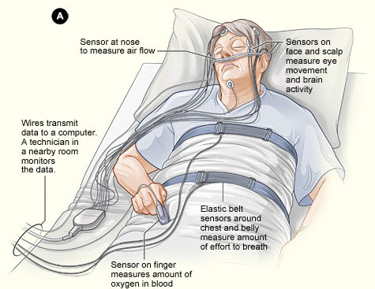
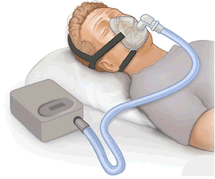
HTN type
Secondary HTN - OSA
Polysomnography
Weight loss and CPAP , biPAP during sleep

Slide 57
HTN type
Secondary HTN – Drugs
Oral contraceptives (OCP)
NSAIDs
Tacrolimus , cyclosporine
Antidepressants
Corticosteroids
Decongestants, such as phenylephrine and pseudoephedrine
Some weight-loss medications
Sodium-containing antacids
Erythropoietin
Stimulants, including methylphenidate and amphetamines , cocain

Slide 58
Approach to HTN
Office BP
Home BP
Ambulatory BP monitoring (ABPM)

Slide 59
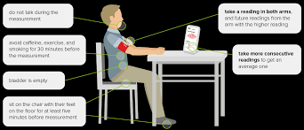
Office BP
Rest for at least 5 min
No smoking or caffeine 30 min ago
No talking
Bare arm , Arm rest on the table at RA level
should be measured in both arms, at least at the initial visit
Proper cuff size (length 80% arm circ , width 40%)
Inflate 20-30 mmHg after radial pulse occluded
Deflate 2 mmHg per seconds
SBP is the first korotkoff sound , DBP is when the sounds end
Repeated at least twice (1-2 min) in 2 visits
Lower limb BP especially in under 30 y.
In older individuals or those with potential orthostatic symptoms, postural measurements should also be taken

Slide 60
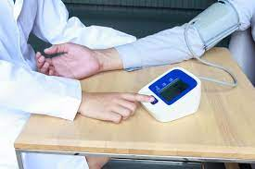
Automated office BP (AOBP)

Slide 61
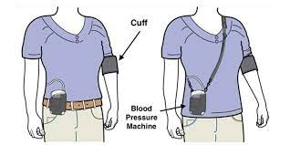
Ambulatory BP monitoring (ABPM)
Daytime (awake) average of SBP ≥130 mmHg or DBP ≥80 mmHg
A 24-hour mean of SBP ≥125 mmHg or DBP ≥75 mmHg
Night time (asleep) mean of SBP ≥110 mmHg or DBP ≥65 mmHg

Slide 62
Ambulatory BP monitoring (ABPM)
ABPM records the blood pressure at preset intervals (usually every 15 to 20 minutes during the day and every 30 to 60 minutes during sleep).
suspected white coat hypertension
Suspected episodic hypertension (eg, pheochromocytoma)
Determining therapeutic response (ie, blood pressure control) in patients who are known to have a substantial white coat effect)
Hypotensive symptoms while taking antihypertensive medications
Resistant hypertension
Autonomic dysfunction
Suspected masked hypertension

Slide 63
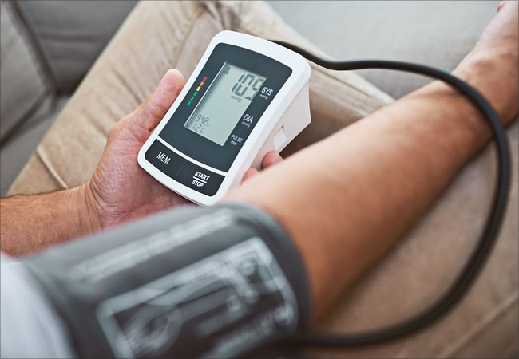
Home BP
Correlate more closely with the results of daytime ABPM.
Repeated home blood pressure readings that average ≥130/≥80 mmHg.

Slide 64
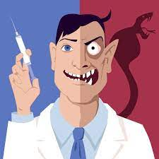
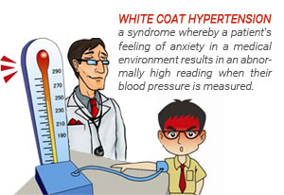
White coat hypertension
Blood pressure that is consistently elevated by office readings but normal at home or in ABPM.

Slide 65

Masked hypertension
Blood pressure that is consistently elevated by out-of-office measurements but normal in office.

Slide 66
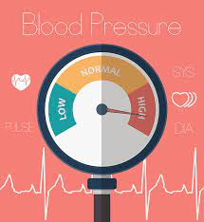
Resistant hypertension
Not reaching goal despite adherence to an appropriate regimen of three antihypertensive drugs of different classes (including a diuretic) in which all drugs ara at suitable doses and after white coat effect has been excluded.
BP that requires at least four medications to achieve control is considered controlled resistant .hypertension
More in > 60 y

Slide 67
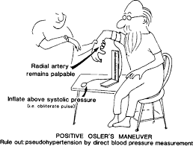
Resistant hypertension
First rule out pseudo resistance :
White coat
Sclerotic arteries : Osler maneuver
Nonadherence : drug , life style
Drugs : NSAID , OCP , Sympatomimc
Work up for secondary cases
Then add Spironolacton or Eplerenon

Slide 68
HTN emergencies
Severe HTN (urgency) : SBP > 180 or DBP >120
If with end organ damage : HTN emergency
End organ damage (HMOD) →
Retinopathy , papilledema
AKI
Encephalopathy
Hemolytic microangiopathic anemia
ACS
Stroke
Dissection
Pulmonary edema
Preeclamcia

Slide 69
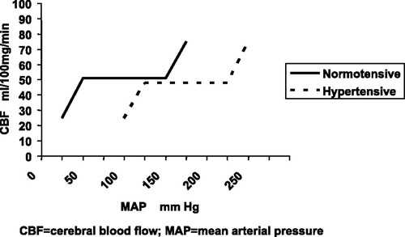

Slide 70
HTN emergencies
Treatment
ICU addmition , with intravenous drugs
Pheochromocytoma or preeclamcia: over 1 h to < 140 mmHg
Aortic dissection : < 120 mmHg
Otherwise :
Over 1 h SBP 25 % decrease
In 2- 6 h reach to 160/100
In 24-48 h reach to normal

Slide 71
HTN emergencies
Treatment
Drug choices :
Dissection : Esmolol , Labetalol
ACS: Esmolol , Nitroglycerine, Nicardipine , Labetalol
AKI: Fenoldopam , Nicardipine , Clevedipine
Preeclamcia : Nicardipine , Labetalol
Ecephalopathy : , Nicardipine , Labetalol , Nitroprusside
Pulmonary edema : Clevedipine , Nitroglycerine , Nitroprusside
Adernergic crisis: Phentolamine , Nitroprusside

Slide 72
HTN urgency
Treatment
No HMOD
No need to addmition
Do not decrease BP rapidly , should be normal in hours or days
If BP> 220/130 →oral short acting drugs : captopril , clonidine , labetalol
Follow up in 24-72 h

Slide 73
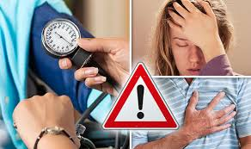
Sign & Symptoms
Silent killer
Headache (morning , occipital)
Dyspnea due to LV dysfunction
Nocturia
Fatigue
Erectile dysfunction

Slide 74
Evaluation
Physical examination
The main goals are:
Signs of end-organ damage
Signs for established cardiovascular disease
For evidence of potential causes of secondary hypertension.

Slide 75
Evaluation
Laboratory testing
Should be performed in all patients with newly diagnosed hypertension :
Electrolytes (including calcium) and serum creatinine
Fasting glucose
Urinalysis
Alb/ Cr ratio
Complete blood count
Thyroid-stimulating hormone
Lipid profile
Electrocardiogram
Calculate 10-year atherosclerotic cardiovascular disease

Slide 76
Testing for secondary hypertension
An unusual presentation of hypertension :
New onset at an especially young or especially old age presentation with stage 2 hypertension
Abrupt onset of hypertension in a patient with previously normal blood pressure
Significant recent elevation in blood pressure in a patient with previously well-controlled hypertension despite adherence to their antihypertensive regimen
Drug-resistant hypertension
The presence of a clinical clue for a specific cause of hypertension, such as an abdominal bruit (suggestive of renovascular hypertension) or low serum potassium (suggestive of primary aldosteronism)

Slide 77
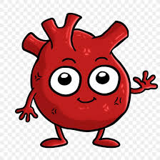
Diagnosis
Hypertensive urgency or emergency (SBP ≥180 mmHg or DBP ≥120 mmHg diastolic)
Initial SBP ≥160 mmHg or DBP ≥100 mmHg diastolic and who also has known target end-organ damage (left ventricular hypertrophy [LVH], hypertensive retinopathy, ischemic cardiovascular disease)
In all other patients who have an elevated office blood pressure, the diagnosis of hypertension should be confirmed using out-of-office blood pressure measurement whenever possible.
ABPM is considered the “gold standard” in determining out-of-office blood pressure.

Slide 78
Diagnosis
Conventional office BP : > = 140 SBP / >=90
AOBP , Home BP , day time ABPM : >=135 / >=85
Night time ABPM :> = 120/ >=70
24/48 h average : >= 130 / >= 80

Slide 79
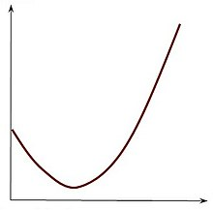
TREATMENT
J curve theory

Slide 80
TREATMENT
Goal: < 130 SBP , < 80 DBP but not < 60
More tight BP control in DM: decrease CV death and microvascular sequlea

Slide 81
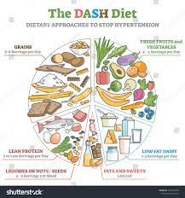
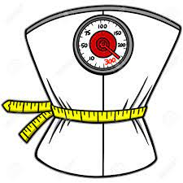



Non pharmacologic therapy
Weight loss –1 mmHg for every 1 kg of weight lost
DASH diet
Dietary salt restriction: < 1500 mg Na
Potassium supplementation : 3500-5000 mg
Exercise – Aerobic: 90 -150 min / w
Limited alcohol intake : < 28 / 14 gr

Slide 82
Who should be treated?!
Patients with out-of-office daytime SBP ≥135 mmHg or DBP ≥85 mmHg (or an average office SBP ≥140 mmHg or DBP ≥90 mmHg)
Patients with an out-of-office blood pressure (mean home or daytime ambulatory) ≥130 mmHg systolic or ≥80 mmHg diastolic (or office readings ≥130 mmHg systolic or ≥80 mmHg diastolic) who have one or more of the following features:
Established clinical cardiovascular disease ( chronic coronary syndrome ,heart failure, carotid disease, previous stroke , PAD)
Type 2 diabetes mellitus
Chronic kidney disease
Age 65 years or older
An estimated 10-year risk of atherosclerotic cardiovascular disease of at least 10 percent

Slide 83
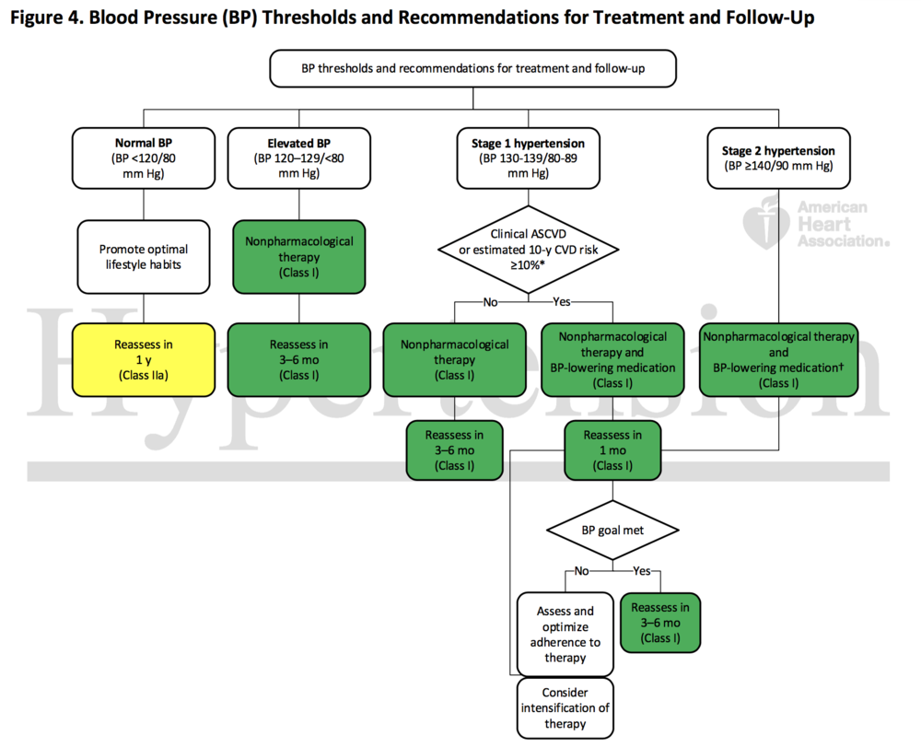

Slide 84
CHOICES
Thiazide-like or thiazide-type diuretics
Long-acting calcium channel blockers (Dihydropyridine such as amlodipine)
RAASI : Angiotensin-converting enzyme (ACE) inhibitors / Angiotensin II receptor blockers (ARBs)

Slide 85
CHOICES
Thiazide-like or thiazide-type diuretics
RAASI : Angiotensin-converting enzyme inhibitors (ACEI ) / Angiotensin II receptor blockers (ARBs)
Calcium channel blockers (Dihydropyridine such as amlodipine)
Beta blockers
Alpha blockers
Sympatholytic
Direct vasodilator

Slide 86

Diuretics

Slide 87
Thiazide-type diuretics
Thiazide-type diuretics:
Inhibits Na- Cl pump in distal tobule → Na excretion , K loss, less ca loss
Vasodilator effect in longterm
More potent with ACEI/ARB
Less potent with CCB

Slide 88
Thiazide-type diuretics
Thiazide-type diuretics adverse effects:
Hypokalemic metabolic alkalosis
Hyperglycemia
Hyperuricemia
Hypercholesterolemia
Hyponatremia

Slide 89

Thiazide-type diuretics
Hydrochlorothiazide → 6.25 – 50 mg /day

Slide 90

Thiazide-type diuretics
Chlortalidone→ longer half life , more potent , more K loss

Slide 91
Thiazide-type diuretics
Caution in acute untreated Goat
Avoid hypokalemia : add K sparing diuretics → Amiloride , triamterene

Slide 92
MRA : mineralocorticoid receptor antagonists
Spironolactone (slight androgenic antagonist)
Eplerenone
Aldosterone receptor blockage → excretion Na
For : Hyperaldosteronism
Resitance HTN
HF

Slide 93
Loop diuretics
Furosmide
Inhibition Na / k / 2 Cl
excretion NaCl and less K
Cause :hypokalemic metabolic alkalosis
Increase urinary Ca / mg
Hypovolemia
Autotoxicity
Hyperuricemia
For : HF + HTN
CKD , cr > 2.5 and retention Na and edema

Slide 94
RAAS inhibitors
ACEI
ARB
direct renin inhibitor: aliskiren

Slide 95
RAAS inhibitors
ACEI :
Decrease ANG II santesis
Increase bradykinin → vasodilator effect
Decrease sympathetic nervous system
Advers effect: more in asian and black
Coughing (15%)
Angioedema (1%)

Slide 96
RAAS inhibitors
ARB:
Losartan
Block AT1
No badykinin → no coughing

Slide 97
RAAS inhibitors
ACEI / ARB : favor effect on glucose metabolism
contraindicated to use together or with direct renin anta
Can cause AKI in renal artery stenosis (due to afferent dilation)
Can cause AKI if : dehydrated , CHF , NSAID
Hyperkalemia

Slide 98

COR | Recommendation for Choice of Initial Medication
I | For initiation of antihypertensive drug therapy, first-line agents include thiazide diuretics, CCBs, and ACE inhibitors or ARBs.
COR | Recommendations for Antihypertensive Medication Adherence Strategies
I | In adults with hypertension, dosing of antihypertensive medication once daily rather than multiple times daily is beneficial to improve adherence.
IIa | Use of combination pills rather than free individual components can be useful to improve adherence to antihypertensive therapy.
Hypertension. 2018;71:e13-e115.

Slide 99


J Hypertens. 2018;36(10):1953-2041.

Slide 100

Thanks for your attention

